Slide 1

Face Mask Dectection
Presented By:
Nada Alruwaythi
Wafaa Alharbi

Slide 2
Table of Contents
01
02
03
04
Introduction
Data &Tool
Models
Results

Slide 3

Introduction
The COVID 19 pandemic is causing a worldwide health crisis. Wearing a face mask in public places and whatever else is the most effective safety gear.

Slide 4
Solution
Develop a system that detects through the camera if the person is wearing a
mask , without mask or wearing mask incorrectly.

Slide 5








Tools
Tensorflow
OpenCV
Keras
Streamlit
Matplotlib
Sklearn
Plotly
imutils.video for Video Stream

Slide 6
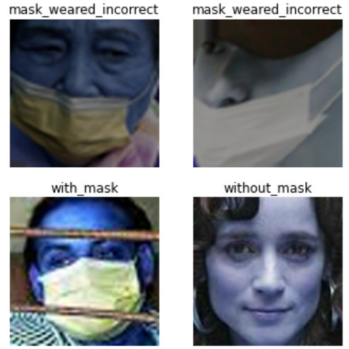
Data
Resource
Kaggle with a total of 8982 images
Image quality
Different Quality
Close up face only
split dataset
Train -> 7130 images
Test -> 899 images
Validation -> 899 images
Sorted by each class label

Slide 7
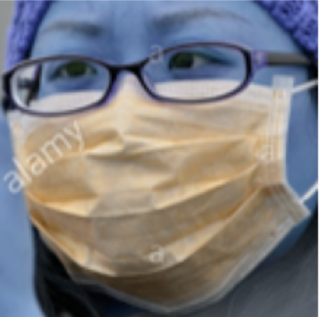
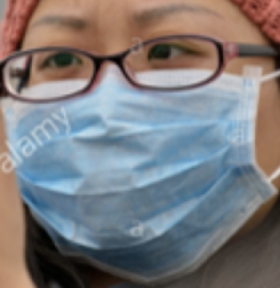
EDA
No Class imbalance issue
2994 images for each class
Convert BGR and RGB with OpenCV function
Notes:
After Convert BGR and RGB with OpenCV function cvtColor()

Slide 8
Workflow
Data
Pre-processing
Simple NN
Transfer Learning
1
2
3
4
5
6
CNN
MobileNetV2
VGG 16
VGG 19
InceptionV3
Results
Baselin
Logistic Regression
Notes:
Set images size 128 x 128

Slide 9
Baseline
1
Logistic Regression:
Training: 96%
Validation: 92%
Test: 92%

Slide 10
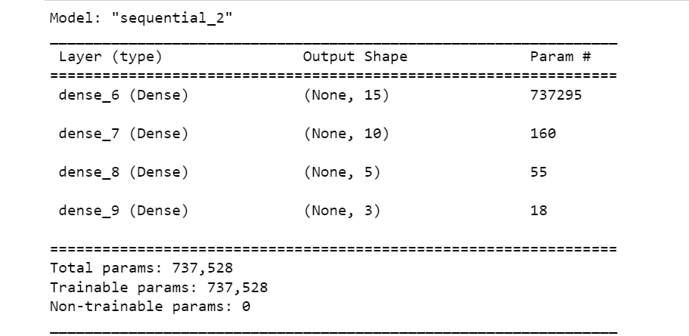
Simple NN
2
Accuracy Score:
Training: 33%
Validation: 33%

Slide 11
3
CNN
Experiment 1
Experiment 2
Conv2D + Maxpooling
Different size of filters : 32,128
Flatten
optimizer : Adam
Dropout(.05): only 5 %
ReduceLROnPlateau
EarlyStopping
optimizer : Adagrad
Experiment 3
Experiment 4
Add more layers
Dense try 512
Regularizer
Notes:
Experiment 2 >> Fully Connected Layers

Slide 12
CNN
3
 | Training | Validation
Experiment 1 | 97% | 95%
Experiment 2 | 99% | 97%
Experiment 3 | 93% | 92%
Experiment 4 | 98% | 97%

Slide 13
4
Transfer Learning Model
 | Training | Validation
MobileNetV2 | 99% | 95%
VGG 16 | 99% | 99%
VGG 19 | 100% | 99%
InceptionV3 | 93% | 93%

Slide 14
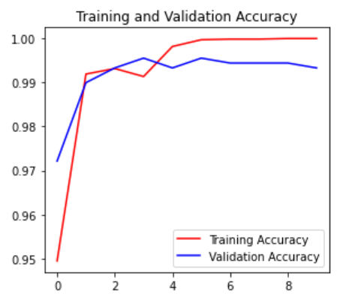
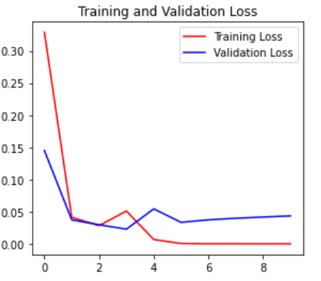
Best Model
VGG 19 Model
Accuracy Score:
- Training: 100%
- Validation: 99%
- Test: 98%

Slide 15
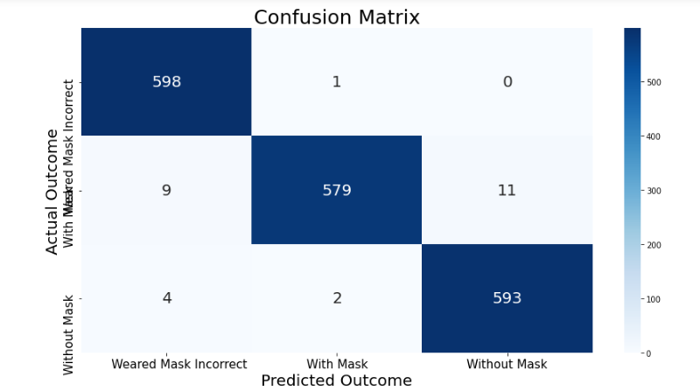
get 27 wrong predictions out of 1797 samples.

Slide 16



Results
1- Face-Detector cloud environment
Trained model
User
Face Detector website App

Slide 17
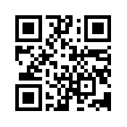
Demo.. (Try it with us)

Slide 18
2- Face-Detector in real-time video streams
VGG16 Model
Video stream app
Deploy

Slide 19
Thanks♥ Any Questions

